Slide 1
Data types
Data types specify the different sizes and values that can be stored in the variable.

Slide 2
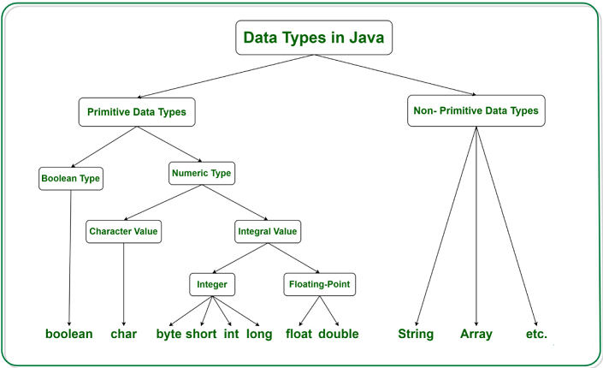

Slide 3
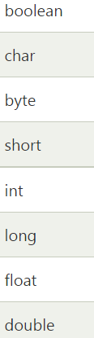


Slide 4
Variable
A variable is a piece of memory that can store a value and the value is which is stored in the memory is depending upon the it’s data type.
The following is the syntax to declare a variable in java
Syntax:
datatype variablename;
Ex:
int a;
float b;
char c;
etc…
To declare multiple variables
Syntax:
datatype variable1,variable2,….variablen;
Ex:
int m,n;
float a,b,c;
char p,q,r,s; etc…..

Slide 5
The following syntax is used to initialize value of a variable
Syntax :
datatype variablename=value;
Ex:
int a=100;
float = 123.455908;
boolean st=true; etc….
For multiple variables
Syntax:
datatype variable1=value1,varible2=value2,…..,variablen=valuen;
Ex:
int x=200,n=300,i=12;
boolean st1=true,st2=false;
etc….

Slide 6
Operators
Operator is a symbol which is used to perform operations.
There are many types of operators in Java
Unary Operator
Arithmetic Operator
Shift Operator
Relational Operator
Bitwise Operator
Logical Operator
Ternary Operator
Assignment Operator

Slide 7
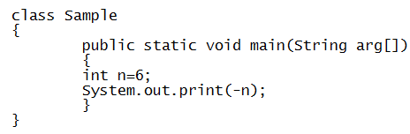
Unary Operators
Java unary operators are the types that need only one operand to perform any operation like increment, decrement, negation etc.
1. Unary minus(-): This operator can be used to convert a negative value to a positive one.
Output : -6

Slide 8
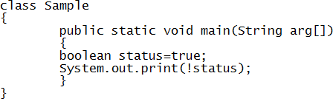
2. ‘NOT’ Operator(!): This is used to convert true to false or vice versa. Basically it reverses the logical state of an operand.
Output : false

Slide 9
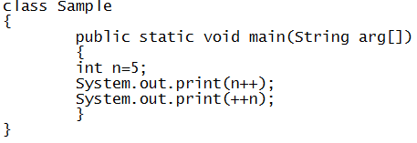

3. Increment(++): It is used to increment the value of an integer. It can be used in two separate ways:
Post-increment operator: When placed after the variable name
Pre-increment operator: When placed before the variable name

Slide 10
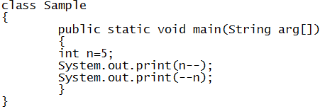

4. Decrement(--): It is used to decrement the value of an integer. It can be used in two separate ways:
Post-decrement operator: When placed after the variable name
Pre-decrement operator: When placed before the variable name

Slide 11



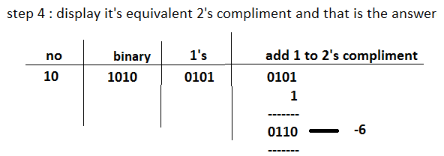
5.Bitwise Complement(~): This unary operator returns the one’s complement representation of the input value or operand, i.e, with all bits inverted, means it makes every 0 to 1, and every 1 to 0.

Slide 12
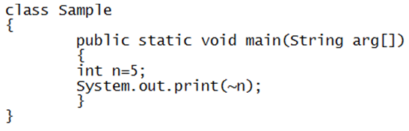


Slide 13
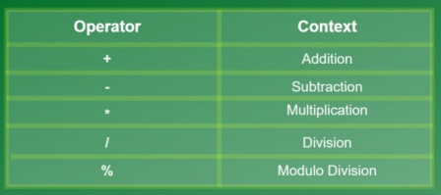
Arithmetic operators
Java arithmetic operators are used to perform addition, subtraction, multiplication, division and remainder operations.

Slide 14
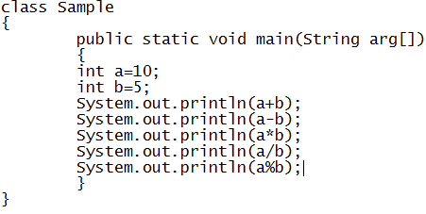
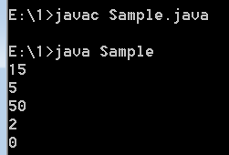
Output:

Slide 15
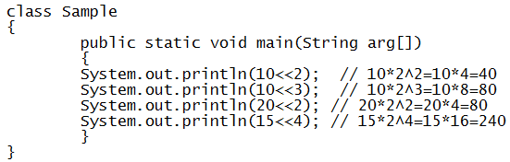
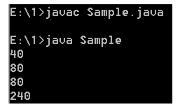
Shift operator
A shift operator performs bit manipulation on data by shifting the bits of its first operand right or left.
1. Left shift operator
The Java left shift operator << is used to shift all of the bits in a value to the left side of a specified number of times
Output:

Slide 16
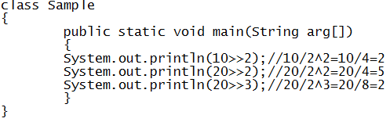
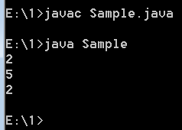
2. Right shift operator
The Java right shift operator >> is used to move left operands value to right by the number of bits specified by the right operand.

Slide 17
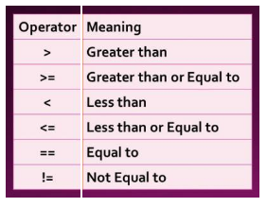
Relational Operators
Relational Operators in Java are used to comparing two variables for equality, non-equality, greater than, less than, etc. Java relational operator always returns a boolean value – true or false.

Slide 18
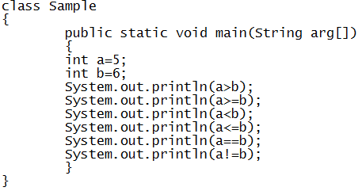
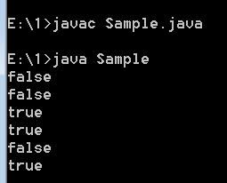

Slide 19
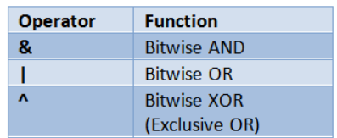
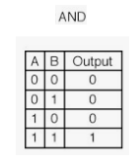
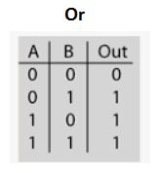
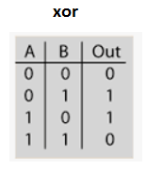
Bitwise operators
Bitwise operators are used to performing manipulation of individual bits of a number.

Slide 20
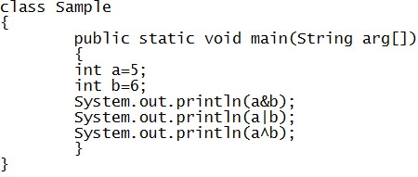
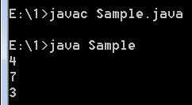

Slide 21
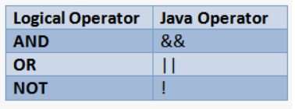
Logical operators
A logical operator (sometimes called a “Boolean operator”) in Java programming is an operator that returns a Boolean result that's based on the Boolean result of one or two other expressions

Slide 22
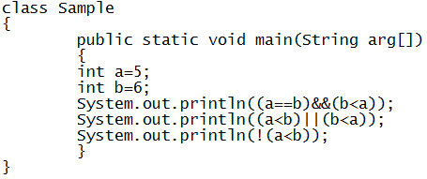
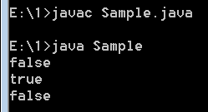

Slide 23
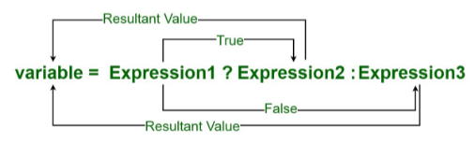
Java Ternary Operator
Java Ternary operator is used as one liner replacement for if-then-else statement.
It is the only conditional operator which takes three operands .

Slide 24
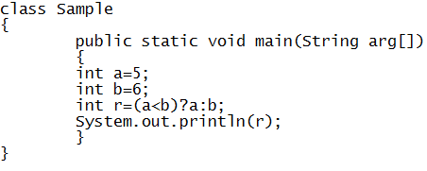
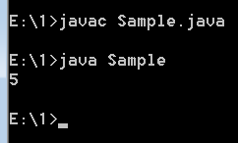

Slide 25

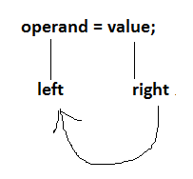
Assignment operators
Assignment operators are used in Java to assign values to variables. For example, int age; age = 5; Here, = is the assignment operator. It assigns the value on its right to the variable on its left.

